Slide 2

Learning objectives
In this lesson students will learn to:
Define what is meant by the 'stored program concept’
Describe the hardware components used in the von Neumann architecture and explain their role in the fetch-decode-execute cycle.
For more details on this topic and additional student activities see Topic 3 of the student book.
© Pearson Education Ltd 2020. Copying permitted for purchasing institution only.
Notes:
Specification content: 3.1.1

Slide 3
Key areas to make notes –
Make sure that you have written worked examples

Slide 4

Starter
A laptop and smartphone are both examples of computer systems
  What are the input and output devices for these computer systems?
  What component carries
  out the processing of
  the instructions?

Slide 5
Starter
Input devices:
  Laptop: keyboard, buttons, trackpad, microphone
  Smartphone: microphone, buttons, GPS sensor, gyroscopic sensor, touch part of the touchscreen
Output devices:
  Laptop and smartphone: speakers, display
Processing:
  CPU (Central Processing Unit)

Slide 6
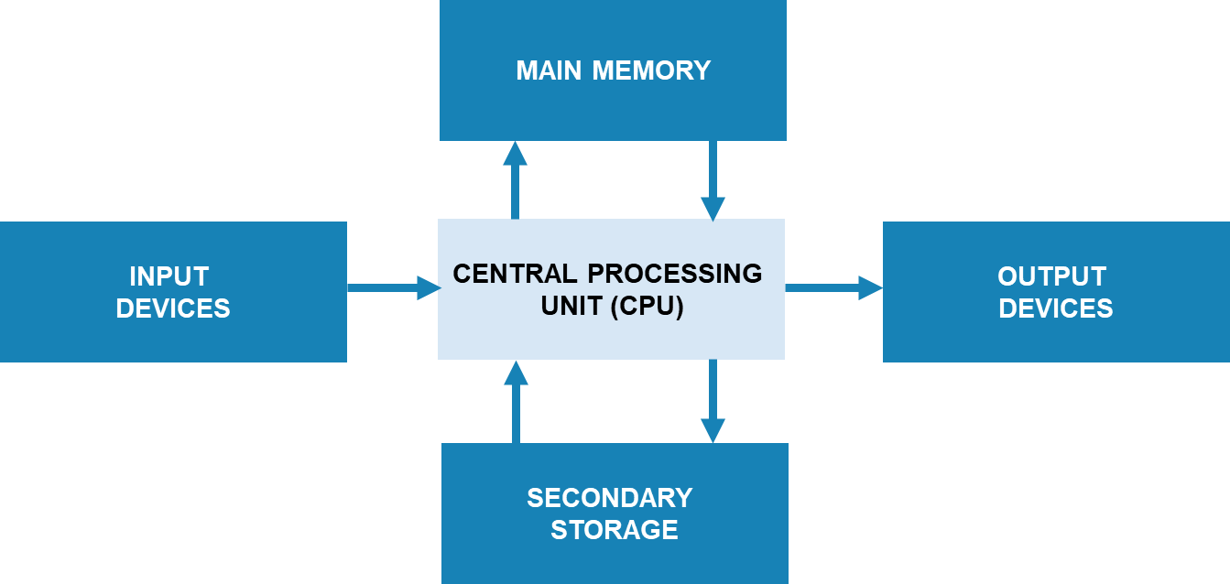
The main components
of a computer

Slide 7
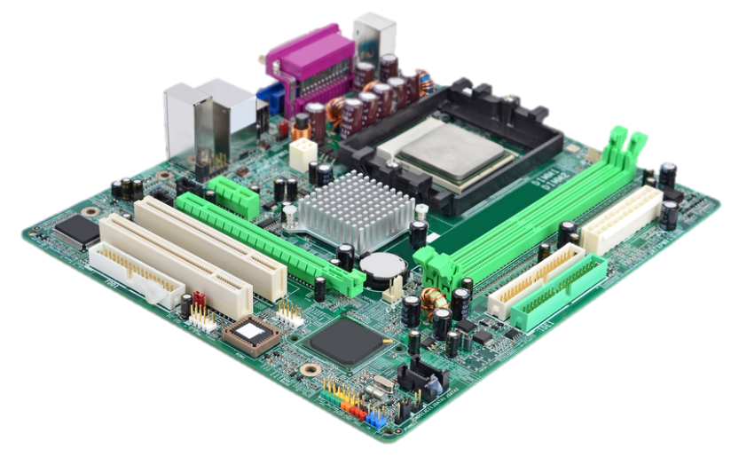
What is this?

Slide 8
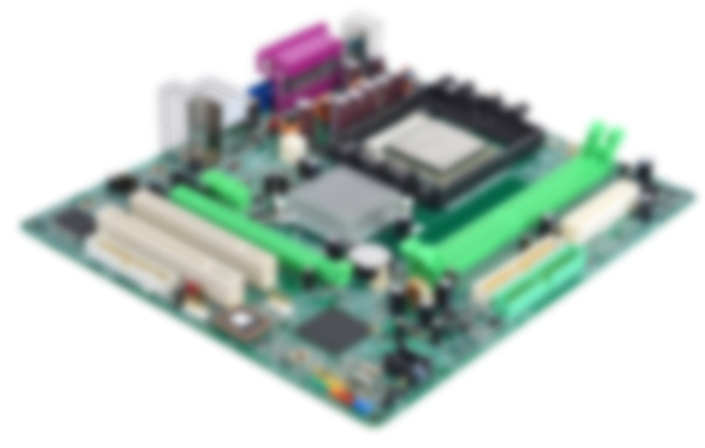
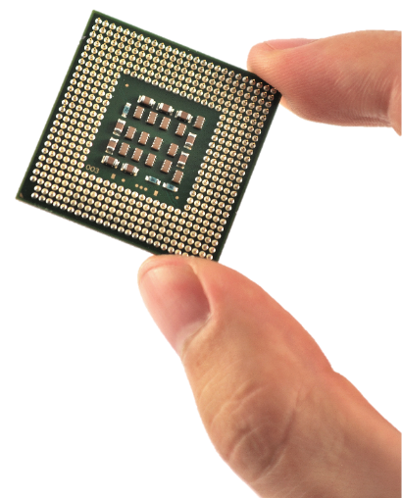
The CPU

Slide 9
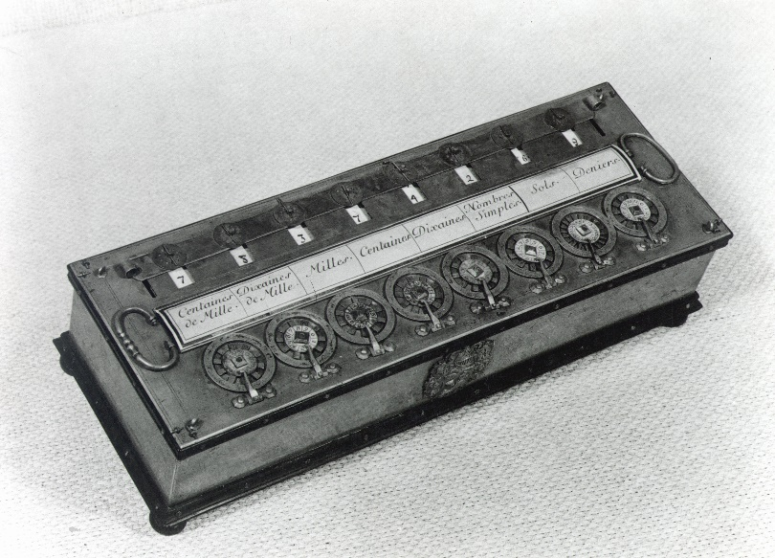
A little history
As long ago as the 1640s,
Mathematicians were creating
mechanical devices that could
perform mathematical operations.
They had hundreds or even
thousands of moving parts.
These devices were created to fulfil a single
purpose. If you wanted to change the purpose of such a device, it needed to be rebuilt or rewired.
Pascal’s calculator (shown here) was designed and built by the famous mathematician in 1642 (when he was 19 years old!) to help him with tax calculations. It performed multiplications and divisions.
© Pearson Education Ltd 2020. Copying permitted for purchasing institution only.

Slide 10
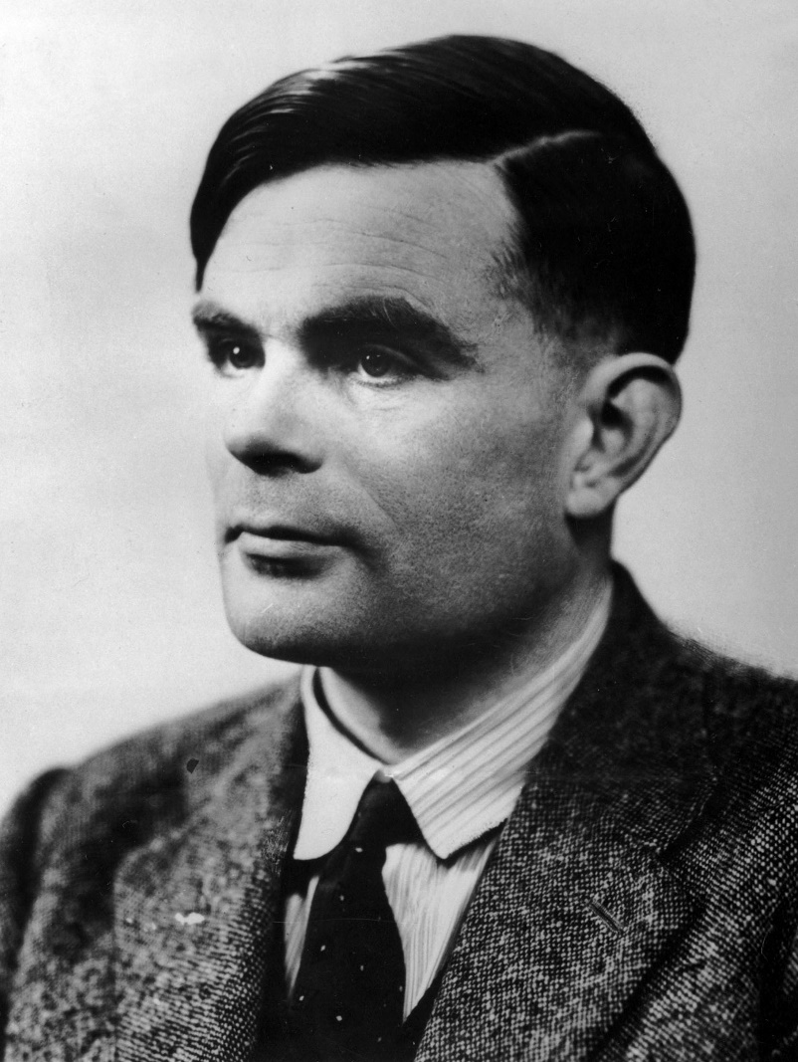
Programmable machines
In 1936, Alan Turing proposed a device he called the ‘Universal Computing Machine’.
He proposed that a computing machine could be designed that could be ‘programmed’ by giving it instructions on punched tape.
It was around this time that the work of engineer Tommy Flowers meant that computing devices were becoming electrical instead of mechanical machines.
© Pearson Education Ltd 2020. Copying permitted for purchasing institution only.
Notes:
https://student.craigndave.org/videos/gcse-edexcel-topic-3a-von-neumann-architecture

Slide 11
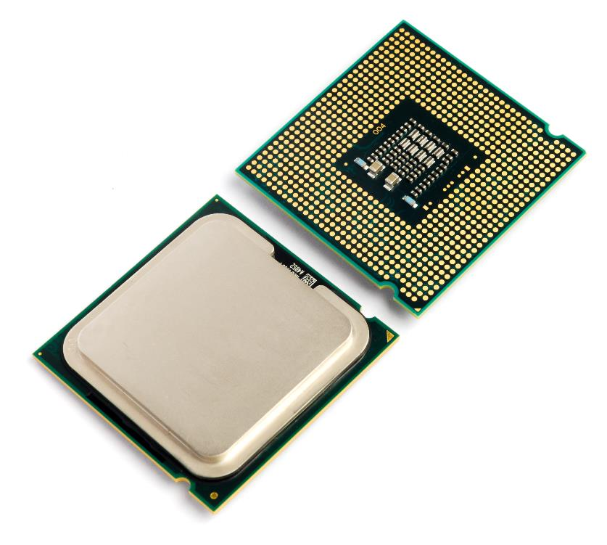

Central Processing Unit (CPU)
The Central Processing Unit or CPU is arguably the most important component of a computer
What does it do?
  What organ in the human body
  is it often compared to?
  What are the similarities it has
  to this organ?

Slide 12



The purpose of the CPU
The CPU processes instructions
  When you run a program, it is the
  CPU which runs the instructions
It is often thought of as being
the ‘brains’ of the computer
  The way that a brain works is
  very different to a CPU
  A CPU simply runs one
  simple instruction at a time
  It carries out billions of
  instructions per second

Slide 13
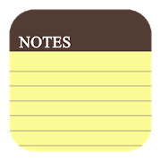
Stored program concept
In the early 1940s, computers stored the data to be worked on in memory
The program was not stored
  Instructions were input one at a time using switches, or read in punch cards and executed one at a time
In 1943-44, mathematician von Neumann and his colleagues had the idea of storing the program instructions as well as the data in memory
The stored-program computer was born!

Slide 14
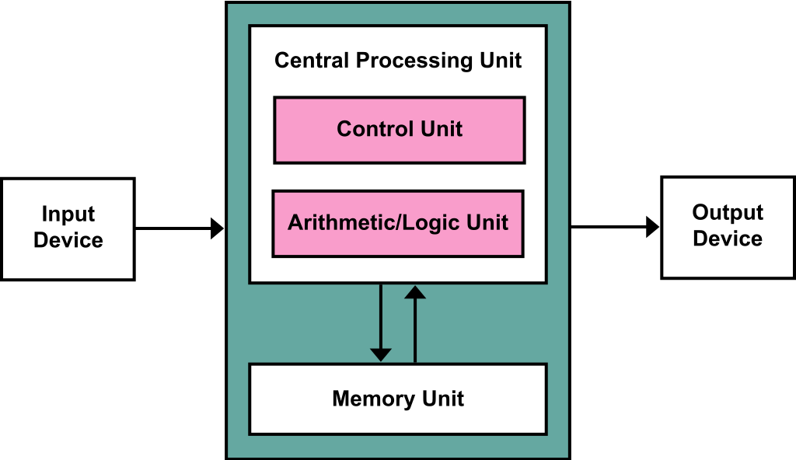
Von Neumann Architecture
Nearly every modern computer uses von Neumann’s structure.
Made up of the following components:
a processing unit containing an arithmetic logic unit and processor registers
a control unit that contains an instruction register and program counter register
memory that stores both data
and instructions
external data storage
input and output mechanisms
© Pearson Education Ltd 2020. Copying permitted for purchasing institution only.
Notes:
Tutor: show after activity, for first 5 minutes only: https://student.craigndave.org/videos/gcse-edexcel-topic-3a-von-neumann-architecture
Student Activity 1

Slide 15
Fetch decode execute
The CPU follows three steps in order to process data.
The process is known as the fetch-decode-execute cycle (sometimes shortened to the fetch-execute cycle).
To begin with, whenever you open and work with a program, its data and instructions are loaded into your computer’s RAM.
As the RAM is accessed directly by the CPU, the CPU can get to work!
© Pearson Education Ltd 2020. Copying permitted for purchasing institution only.

Slide 16
Fetch
The CPU fetches data and instructions from the main memory (RAM) and then stores them in its own temporary, very fast memory called registers.
Can I have some data?
CPU
RAM / Memory
Yes! Here it is!
© Pearson Education Ltd 2020. Copying permitted for purchasing institution only.

Slide 17
Fetch
The CPU uses a hardware path called the address bus.
The memory address of the next item that the CPU wants is put onto the address bus.
Data from this memory address then travels from the RAM to the CPU on another hardware path called the data bus.
CPU
RAM / Memory
Address
Bus
CPU
Data
Bus
RAM / Memory
© Pearson Education Ltd 2020. Copying permitted for purchasing institution only.

Slide 18
Decode
Decode - involves the CPU working out what the instruction it has just fetched actually means.
The control unit decodes the instruction and gets ready for the next step.
It looks up the instruction from the instruction set. This is the full list of operations that a microprocessor can carry out.
© Pearson Education Ltd 2020. Copying permitted for purchasing institution only.

Slide 19
Execute
The execute stage is the point at which data processing happens.
Instructions are carried out on the data. Some instructions are carried out by the arithmetic logic unit (adding, shifting, AND, OR, etc.).
Once a cycle has completed, another begins.
© Pearson Education Ltd 2020. Copying permitted for purchasing institution only.

Slide 20
Fetch decode execute
Instructions and data are stored in the memory.
Instructions are fetched one at a time into the processor.
The instructions are decoded by the control unit.
The instructions are executed, sometimes using the arithmetic logic unit.
© Pearson Education Ltd 2020. Copying permitted for purchasing institution only.
Notes:
Student Activity 2

Slide 21
Wrap up: you have learned how to…
Define what is meant by the 'stored program concept’.
  Early computers had a single function and needed to be rewired or rebuilt for different functions.
  Programs stored inside the computer.
  All modern computers can be reprogrammed.
  Describe the hardware components used in the von Neumann architecture and explain their role in the fetch-decode-execute cycle.
  The memory holds the program’s instructions and data.
  The CPU contains the control unit and arithmetic logic unit used to carry out the instructions.
  The address bus holds the address in memory and the contents are passed along the data bus.
© Pearson Education Ltd 2020. Copying permitted for purchasing institution only.

